Slide 1
Welcome
to
Thesis Protocol Presentation

Slide 2
THESIS TITLE
Vitamin B12 Status in Long-term Metformin Treated Type 2 Diabetes Mellitus (T2DM) patients

Slide 3
Investigator
Dr. Abu Kamran Rahul
Resident (Phase-B)
MD (Internal Medicine)
Department of Medicine
Sylhet MAG Osmani Medical College, Sylhet

Slide 4
Guide
Prof. Dr. Moniruzzaman Ahmed
Professor
Department of Medicine
Sylhet MAG Osmani Medical College, Sylhet

Slide 5
Co-Guide
Dr. Md. Enayet Hossain
Associate Professor
Department of Medicine
Sylhet MAG Osmani Medical College, Sylhet

Slide 6
Co-Guide
Dr. Habibur Rahman
Assistant Professor
Department of Endocrinology
Sylhet MAG Osmani Medical College, Sylhet

Slide 7
Introduction
Diabetes mellitus (DM) is a metabolic disorder affecting about 424.9 million people worldwide with the majority of the patients (about 90%) having type 2 DM and it is apprehended that by the year of 2045, it will be 628.6 million, or one adult in 10 will have diabetes.

Slide 8
Introduction continue…
In Bangladesh a total 6.9 million diabetic people in 2017 with national prevalence of 6.9% and it is estimated that in 2045 around 13.7 million of her people will have diabetes, with a prevalence of 14.95% that will make 9th ranked county in the world at that time (IDF, 2017).

Slide 9
Introduction continue…
DM is associated with the development of the specific micro- and macro-vascular complications. Peripheral neuropathy is one of the microvascular complications of diabetes which carries the risk of foot ulcers and amputation (Kalbarti GM, 2010).

Slide 10
Introduction continue…
Almost 30% of people with diabetes aged 40 years or older have impaired sensation in the feet (CDC, 2011). Up to 50% of Diabetic peripheral neuropathy (DPN) may be asymptomatic (ADA, 2018). Mørkrid et al. found 19.7% patients to have DPN among the type 2 diabetic outpatients at the BIRDEM hospital, Bangladesh (Mørkrid et al., 2010).

Slide 11
Introduction continue…
Metformin (1,1-dimethylbiguanide hydrochloride) belongs to the biguanide class of drugs which are guanidine derivatives. Metformin has been used in Europe and Canada for more than 50 years (since 1957); the US Food and Drug Administration (FDA) approved it later in December 1994 (Bouchoucha et al., 2011).

Slide 12
Introduction continue…
Past and recent recommendations from the American Diabetes Association (ADA) and the European Association for the Study of Diabetes (EASD) propose that metformin therapy (in the absence of contraindications) has to be initiated, concurrent with lifestyle intervention, at the time of DM diagnosis

Slide 13
Introduction continue…
The mechanisms of metformin action are little understood. It is effective only in the presence of insulin and reduce hyperglycaemia primarily by suppressing glucose production by the liver (hepatic gluconeogenesis) and decreased glucose uptake (Kirpichnikov et al., 2002 ).

Slide 14
Introduction continue…
In addition to suppressing hepatic glucose production, metformin increases insulin sensitivity, enhances peripheral glucose uptake, increases fatty acid oxidation, and decreases absorption of glucose from the gastrointestinal tract (Collier et al., 2006).

Slide 15
Introduction continue…
Various studies have shown increased prevalence of vitamin B12 deficiency in patients with type 2 diabetes mellitus on Metformin therapy (Khan et al., 2017; Iftikhar et al., 2013). Vitamin B12 deficiency is traditionally diagnosed by laboratory findings of low serum vitamin B12 levels, typically in the setting of megaloblastic anemia.

Slide 16
Introduction continue…
The mechanism by which metformin therapy causes vitamin B12 deficiency is not clear, but it is thought to be due to either alteration in small bowel motility, which stimulate small bowel bacterial overgrowth and subsequent vitamin B12 deficiency, or by directly decreasing vitamin B12 absorption (Kumar et al., 2013; Albers et al., 2012).

Slide 17
Introduction continue…
The deficiency of vitamin B12 occurs on Metformin therapy as dose and duration dependent manner, even within 6 weeks to 3 months of commencing Metformin (Chapman et al., 2016). Irrespective of the established association between metformin and vitamin B12 deficiency, the true problem has not yet been accurately quantified.

Slide 18
Introduction continue…
Prior studies have indicated that the occurrence of vitamin B12 deficiency due to metformin differed immensely and ranged between 5.8% and 52%(Bauman et., 200, de Jager J et al., 2010, Briani C et al., 2013).

Slide 19
Introduction continue…
However, there are some conflicting reports on the association between Metformin-induced B12 deficiency and neuropathy, with some reports showing an association while others have refuted this (Russo et al., 2016; Ahmed et al., 2016; Ma J et al., 2015; Elhadd et al., 2018)

Slide 20
Introduction continue…
In a study of Bangladesh, vitamin B12 is found sufficient in newly diagnosed T2DM patient (Abm and Ghosh, 2016). Metformin use has been implicated as a cause of vitamin B12 deficiency in patients with diabetes but vitamin B12 deficiency has been also found in diabetic patients not taking metformin (Jawa et al., 2010, Ebesunun at al., 2012). Barghouti et al. found that diabetic patients are less likely to have B12 deficiency in comparison to nondiabetic subjects (Barghouti et al., 2009)

Slide 21
Introduction continue…
Peripheral neuropathy caused by diabetes mellitus and vitamin B12 deficiency may produce overlapping clinical pictures (Sachedina, 2013). Moreover; nondiabetic neuropathies may be present in patients with diabetes and may be treatable (ADA, 2018). Several published studies reported that therapeutic supplementation with B12 or vitamin B complex mixtures containing B12 significantly improved symptoms in diabetic neuropathy patients (Sun et al, 2005, Dominguez et al, 2012)

Slide 22
Introduction continue…
Therefore, measurement of serum B12 level in patients with T2DM with or without Metformin therapy may help in exploring concurrent B12 deficiency, a condition which can be treated very easily. The present study aims to find out the serum vitamin B12 status in type 2 diabetic patients and also would attempt to correlate the deficiency status with peripheral neuropathy and metformin use, if so present.

Slide 23
RATIONALE
Type 2 DM is a major health related issue in the world including Bangladesh and the prevalence of type 2 diabetes mellitus is increasing gradually. Metformin is a cornerstone of oral antidiabetic agent for the treatment of type 2 diabetes.

Slide 24
Rationale continue…
Several studies have shown Long-term use of metformin may be associated with biochemical vitamin B12 deficiency and clinical neuropathy. But there are some conflicting reports on the association between Metformin-induced B12 deficiency and neuropathy have refuted this.

Slide 25
Rationale continue…
Studies on vitamin B12 in T2DM are very limited in Bangladesh. The frequency of vitamin B12 deficiency in patients with T2DM on Metformin therapy in Bangladesh is unknown and the measurement of serum vitamin B12 in T2DM patients on Metformin is not a part of the standard annual review examination.

Slide 26
Rationale continue…
Vitamin B12 deficiency also leads to development of peripheral neuropathy which may be indistinguishable clinically from diabetic peripheral neuropathy. Treatment of diabetic peripheral neuropathy or metformin-induced peripheral neuropathy with vitamin B12 supplementation resulted in clinical improvement of symptoms.

Slide 27
Rationale continue…
So, now the question arising whether the diabetic patients on long-term metformin therapy should undergo routine screening for vitamin B12 deficiency or routine supplementation of vitamin B12 should be given to diabetic patients. Present study aimed to find out the serum vitamin B12 status in patients with type 2 diabetes mellitus on long-term metformin therapy

Slide 28
Research question
What is the status of vitamin B12 in T2DM patients who were treated with long-term metformin in comparison to those patient who were not treated with metformin ?
Hypothesis
Vitamin B12 is significantly decreased in metformin treated T2DM group in comparison to not metformin treated T2DM group

Slide 29
Objectives
General objective:
To determine serum vitamin B₁₂ level and its frequency in patients with type 2 diabetes mellitus on lon-term Metformin therapy

Slide 30
Objectives
Specific objectives:
To determine serum vitamin B₁₂ level in patients with type 2 diabetes mellitus on metformin or not on metformin therapy
To determine presence of peripheral neuropathy in patients with type 2 diabetes mellitus.
To observe association between vitamin B₁₂ level with presence of peripheral neuropathy, metformin use and glycemic status (HbA1C).

Slide 31
Methodology
Study design
Cross-sectional observational study
Study period
1 year after acceptance of protocol

Slide 32
Methodology continue…
Study population & place
Study population will be Non-pregnant adults with type 2 DM currently on Metformin therapy attending either OPD (Outpatient care) or IPD (Inpatient care) of Sylhet MAG Osmani Medical College Hospital (SOMCH) and equal number of age and sex matched T2DM patients who are not on metformin therapy.
Sampling method:
Convenient sampling method

Slide 33
Sample size
Sample size: n = Z ² pq/d²
Z = 1.96 (in 95% Confidence Interval)
p = Expected proportion in population based on previous studies = 22.4% (0.0224) (Damiao et al., 2015), q= 1-p
d = Absolute error or precision. Usually it is taken as 10% (0.1).
Sample size (n) = [1.96² × 0.0224 × 0.776] / [0.001]²
= 65.92
So intended sample size (n) = 66

Slide 34
Inclusion criteria:
Non-pregnant adults with type 2 DM taking Metformin at any dose for at least one year.
Control group will contain equal number of age and sex matched non-pregnant adults with type 2 DM for at least one year not on Metformin therapy or no history of metformin use for last 1 year)

Slide 35
Exclusion criteria:
Patients with diagnosis of pernicious anaemia, malabsorption, gastrointestinal surgery, malnutrition, history of thyroid disease or a history of other organ-specific autoimmune conditions.
Known cases of End stage renal disease(ESRD), Chronic Kidney Disease(CKD) e-GFR <50ml/min/1.73m²
Chronic liver disease (CLD)
Pure vegans

Slide 36
Exclusion criteria continue…
Chronic (3 months or more) use of acid suppressants i.e. Proton pump inhibitors or H2 receptor blockers
Concomitant drugs use that affect vitamin B12 level (e.g. Corticosteroids, phenytoin, dihydrofolate reductase inhibitors)
Multivitamin or B12 supplementation during the last 6 weeks
Poor drug compliance

Slide 37
Variables
Main outcome variables:
Serum vitamin B12 level
HbA1C
Duration of DM
Duration of metformin use
Total daily dose of Metformin

Slide 38
Variables
Demographic variables:
Age
Height
Weight
Body Mass Index (BMI)
Waist Circumference (cm)
Blood pressure
Smoking status

Slide 39
Variables
Other variables:
Random plasma glucose
Serum creatinine
Haemoglobin concentration, MCV (mean corpuscular volume

Slide 40
Quality assurance
Regular instruction from the supervisor will be taken. Collected data will be checked periodically

Slide 41
Operational definitions:
Peripheral neuropathy: Peripheral Neuropathy will be screened by using Toronto Clinical Neuropathy Scoring System and presence of peripheral neuropathy will be interpreted as following:
No neuropathy (1): 0-5 points
Mild neuropathy (2): 6-8;
Moderate neuropathy (3): 9-11
Severe neuropathy (4): 12+

Slide 42
Operational definitions continue…
Serum vitamin B12 level status:
Deficiency: ≤200 pg/ml
Borderline deficiency: >200 to ≤300 pg/ml
Normal: >300 pg/ml. (Carmel R et al., 2003)
Controlled Daibetes: here, controlled diabetes is defined as diabetic patients having HbA_{1c} ≤7.0% (Ferroni P etal., 2004)
Uncontrolled Diabetes: Here, Uncontrolled diabetes is defined as HbA_{1c} >7.0%

Slide 43
Operational definitions continue…
Dose of Metformin :
1-1000mg: Low dose (Stanley, 2018)
1001-1999mg: Moderate intensity dose
>2000mg: High dose
Long term medications : Use of Metformin for more than 1 year
Smoking status :
Light smokers (< 10 cigarettes/day)
Heavy smokers (10–15 cigarettes /day)
Very heavy smokers (> 15 cigarettes /day) (Stanley, 2014)

Slide 44
Operational definitions continue…
Waist Hip circumference : 90cm or more (in male), 80cm or more (Female) significant
Hypertension: known hypertensive or patients having 2 careful readings of office blood pressure ≥130/80 mm of Hg (AHA, 2017)
BMI: Body mass index will be calculated by equation =Weight in Kilogram / Height in meter. According to World Health Organization (WHO) recommendation for Asians, BMI>23.0 kg/m² will be considered as overweight and >25.0 kg/m² will be considered as obese

Slide 45
Procedures of preparing and organizing materials:
Those patients, who fulfill the inclusion criteria will be included in the study. Then sample will be collected from either IPD or OPD Sylhet MAG Osmani Medical College Hospital (SOMCH). Informed written consent will be taken from each study subject after complete explanation of the steps and purpose of the study. Data will be collected by using semi-structured questionnaire and will be recorded in the data collection sheet.

Slide 46
Procedures of preparing and organizing materials:
Then clinical examination will be done. Peripheral neuropathy will be elicited by using Toronto Clinical Scoring System

Slide 47
Procedures of preparing and organizing materials:
Then 5 ml venous blood will take from each subject in two separate test tubes maintaining all aseptic precaution. Then serum assay for HbA1c and vitamin B12 on the same day of blood sample collection (preferably within 08 hours). Separated serum was discarded if vitamin B12 assay could not be done within the same day.

Slide 48
Procedures of preparing and organizing materials:
Serum vitamin B12 will be measured by Chemiluminescent Microparticle Immunoassay (CMIA) technology, HbA1C by High Performance Liquid Chromatography (HPLC) method, CBC, RBS & S. Creatinine also will be done. Serum vitamin B12 assay will be done at a renowned diagnostic center in Sylhet city by CMIA method via ADVIA Centaur CP machine and rest of investigations will be done in pathology laboratory of Sylhet MAG Osmani Medical College, Sylhet.

Slide 49
Statistical analysis:
Data will be analyzed by using SPSS program (version 23.0). Results will be expressed in frequencies or percentages (mean ± SD and median). Comparison of vitamin B₁₂ level in subgroups will be done by Student’s unpaired t-test. Frequency of reduced vitamin B₁₂ using recommended cut-off values will be compared in between subgroups by Chi-square test. Pearson’s correlation test will be used to observe correlation among different variables (HbA1c, vitamin B₁₂, random blood glucose, age, metformin use etc.). P value ≤0.05 will be considered significant.

Slide 50
Ethical implications:
Ethical clearance will be taken from the ethical review committee of Sylhet MAG Osmani Medical College prior to commencement of study.
Informed written consent will be taken from the patients and study related information will be explained in local language to patients.
Before data collection, the respondents will be told that they are at liberty to participate and to decline to answer any question during the study. The respondents will be given assurance that the findings of the interview/ investigation/ examination will not be used/ disclosed to any unauthorized person or authority other than the research purpose.

Slide 51
Budget considerations
Medicines & Reagents | BDT 2,00,000
Purchasing Literature from the Internet | BDT 5,000
Stationary | BDT 5,000
Questionnaire Adaptation | BDT 5,000
Printing and Photocopying | BDT 15,000
Data Analysis | BDT 10,000
Report Preparation and Presentation | BDT 10,000
 | Grand Total = BDT 2,50,000
Source of funding: Researcher himself

Slide 52
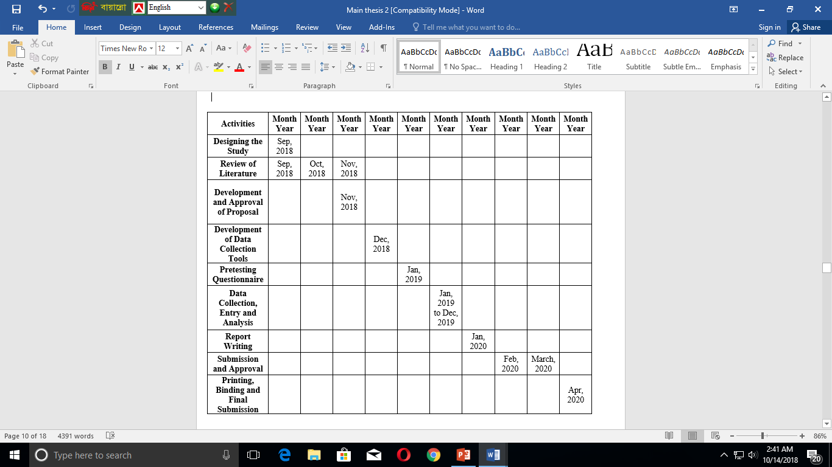
Work plan

Slide 53
REFERENCES
Ahmed MA, Muntingh G, Rheeder P. Vitamin B12 deficiency in metformin-treated type-2 diabetes patients, prevalence and association with peripheral neuropathy. BMC Pharmacol Toxicol (2016) 17:44. doi:10.1186/ s40360-016-0088-3.
Albers U, Pedrero-Chamizo R, Melendez A, Pietrzik K, Castillo MJ, Gonzalez-Gross M 2012.Efficacy of a 28-Day Oral Cyanocobalamin Supplementation on Vitamin B Status in Spanish Institutionalized Elderly. International Journal for Vitamin and Nutrition Research;82(2):104-12.
American Diabetes Association. Clinical Practice Recommendations 2014. Diabetes Care. 2018; 41(Supp 105): S113-118.
Bailey CJ, Turner RC. Metformin. N Engl J Med 1996; 334: 574-579.
Bauman WA, Shaw S, Jayatilleke E, et al.: Increased intake of calcium reverses vitamin B12 malabsorption induced by metformin. Diabetes Care. 2000, 23:1227-31. 10.2337/diacare.23.9.1227.

Slide 54
References continue…
Bottiglieri T, Laundy M, Crellin R, Toone BK, Carney MWP, Reynolds EH. Homocysteine, folate, methylation, and monoamine metabolism in depression. J Neurol Neurosurg Psychiatry. 2000; 69:228-32.
Bouchoucha M, Uzzan B, Cohen R. Metformin and digestivedisorders. Diabetes Metab 2011;37:90–6.
Briani C, Torre CD, Citton V, et al.: Cobalamin Deficiency: Clinical picture and radiological findings. Nutrients. 2013, 5:4521–39. 10.3390/nu5114521.
Carmel R, Green R, Rosenblatt DS, Watkins D. Update on cobalamin, folate, and homocysteine. Hematology Am. Soc. Hematol. Educ. Program 2003. 2003; 62-81.
Centers for Disease Control and Prevention. National diabetes fact sheet: national estimates and general information on diabetes and prediabetes in the United States, 2011. Atlanta, GA: U.S. Department of Health and Human Services, Centers for Disease Control and Prevention; 2011.

Slide 55
References continue…
Chapman LE, Darling AL, Brown JE. Association between metformin and vitamin B12 deficiency in patients with type 2 diabetes: a systematic review and meta-analysis. Diabetes Metab (2016) 42:316–27. doi:10.1016/j. diabet.2016.03.008
Collier CA, Bruce CR, Smith AC, Lopaschuk G, Dyck DJ. Metformin counters the insulin-induced suppression offatty acid oxidation and stimulation of triacylglycerol lstorage in rodent skeletal muscle. Am J Physiol Endocrinol Metab 2006;291:E182–9.
Damiao CP, Rodrigues AO, Pinheiro MF, Cruz RAF, Cardoso GP, Taboada GF, et al. Prevalence of vitamin B12 deficiency in type 2 diabetic patients using metformin: a cross-sectional study. Sao Paulo Med J (2016) 134:473–9. doi:10.1590/1516-3180.2015.01382111
deJager J, Kooy A, Lehert P, Wulffele´ MG, van der Kolk J,Bets D, et al. Long term treatment with metformin inpatients with type 2 diabetes and risk of vitamin B-12 deficiency: randomised placebo controlled trial. BMJ2010;340:c2181.

Slide 56
References continue…
Dominguez JC, Ng AR, Damian LF. A prospective, open label, 24-week trial of methylcobalamin in the treatment of diabetic polyneuropathy. Journal of Diabetes Mellitus. 2012; 2:408-12.
Dujic T, Zhou K, Donnelly LA, Tavendale R, Palmer CN, Pearson ER. Association of organic cation transporter 1 with intolerance to metformin in type 2 diabetes: a GoDARTS study. Diabetes 2015; 64: 1786-1793.
Ebesunun, Maria O, Adetunji, Kehinde J, Obajobi, Esther O. Evaluation of Essential Fatty Acids, Folic Acid And Vitamin B12 in Type 2 Diabetes Mellitus. New York Science Journal. 2012; 5:56-64.
Ferroni P, Basili S, Falco a, Davì G. Platelet activation in type 2 diabetes mellitus. J Thromb Haemost. 2004;2(8):1282–91.
George K, Albarti MM. The Classification and Diagnosis of Diabetes Mellitus. In: Holt RIG, Cockram C, Flyvbjerg A, Goldstein BJ. Textbook of Diabetes. West Sussex: Blackwell Publishing Ltd; 2010. 4th edn: p. 24-30.

Slide 57
References continue…
Iftikhar, R. et al. (2013) ‘Prevalence of Vitamin B12 deficinecy in patients of type 2 diabetes mellitus on metformin: a case control study from Pakistan’, Pan African Medical Journal, 16, pp. 1–6. doi: 10.11604/pamj.2013.16.67.2800.
International Diabetes Federation. IDF Diabetes Atlas, 8th edn. Brussels, Belgium: International Diabetes Federation, 2017.
Jawa AA, Akram J, Sultan M, Humayoun MA, Raza R. Nutrition-related vitamin B12 deficiency in patients in Pakistan with type 2 diabetes mellitus not taking metformin. Endocr Pract. 2010; 16:205-08.
Khan, A., Shafiq`, I. and Hassan Shah, M. (2017) ‘Prevalence of Vitamin B12 Deficiency in Patients with Type II Diabetes Mellitus on Metformin: A Study from Khyber Pakhtunkhwa’, Cureus, 9(8). doi: 10.7759/cureus.1577.
Kirpichnikov D, McFarlane SI, Sowers JR. Metformin: anupdate. Ann Intern Med 2002;137:25–33.
Kumar A, Goel MK, Jain RB, Khanna P, ChaudharyV. India towards diabetes control: Key issues.Australas Med J. 2013;6(10):524-31

Slide 58
References continue…
Ma J, Yu H, Liu J, Chen Y, Wang Q, Xiang L. Metformin attenuates hyperalgesia and allodynia in rats with painful diabetic neuropathy induced by streptozo- tocin. Eur J Pharmacol (2015) 764:599–606. doi:10.1016/j.ejphar.2015.06.010.
Malouf R, Sastre AA. Vitamin B12 for cognition. Cochrane Database of Systematic Reviews. 2003; Issue 3. Art. No.: CD004394.
Mørkrid K, Ali L, Hussain A. Risk factors and prevalence of diabetic peripheral neuropathy: A study of type 2 diabetic outpatients in Bangladesh. Int J Diab Dev Ctries. 2010; 30:11-17.
Nygard O, Nordrehaug JE, Refsum H, Ueland PM, Farstad M, Vollset SE. Plasma homocysteine levels and mortality in patients with coronary artery disease. N Engl J Med. 1997; 337:230-06.
Russo GT, Giandalia A, Romeo EL, Scarcella C, Gambadoro N, Zingale R, et al. Diabetic neuropathy is not associated with homocysteine, folate, vitamin B12 levels, and MTHFR C677T mutation in type 2 diabetic outpatients taking met- formin. J Endocrinol Invest (2016) 39:305–14. doi:10.1007/s40618-015-0365-9.

Slide 59
References continue…
Sachedina S, Toth C. Association of comorbidities with increasing severity of peripheral neuropathy in diabetes mellitus. World J Diabetes. 2013; 15:135-44.
Saxena R, Pati HP, Mahapatra M. De Gruchy’s Clinical Haematology In Medical Practice. 6th Adapted ed. New Delhi: Wiley India Pvt. Ltd; 2013. p. 58-60.
Selhub J, Morris MS, Jacques PF, Rosenberg IH. Folate-vitamin B-12 interaction in relation to cognitive impairment, anemia, and biochemical indicators of vitamin B-12 deficiency. Am J Clin Nutr. 2009; 89(suppl):702S–6S.
Shargosky M, Boaz M, Pasternak S, HanahR, Matas Z, Fux A, Beigel Y, Mashavi M. Serum homocysteine, folate, vitamin B12 levels and arterial stiffness in diabetic patients: which of them is really important in atherogenesis? . 2009; 25:70-75.
Sun Y, Lai MS, Lu CJ. Effectiveness of vitamin B12 on diabetic neuropathy: systemic review of clinical control trials. Acta Neurol Taiwan. 2005; 14:48-54.
Wile DJ, Toth C. Association of metformin, elevatedhomocysteine, and methylmalonic acid levels andclinically worsened diabetic peripheral neuropathy.Diabetes Care 2010;33:156–61.

Slide 60
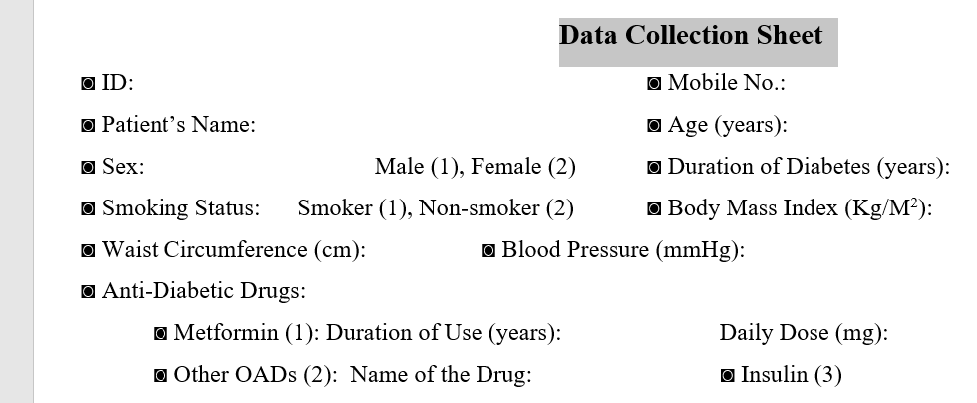
Appendix I
Reg. no:
# Anaemia:

Slide 61
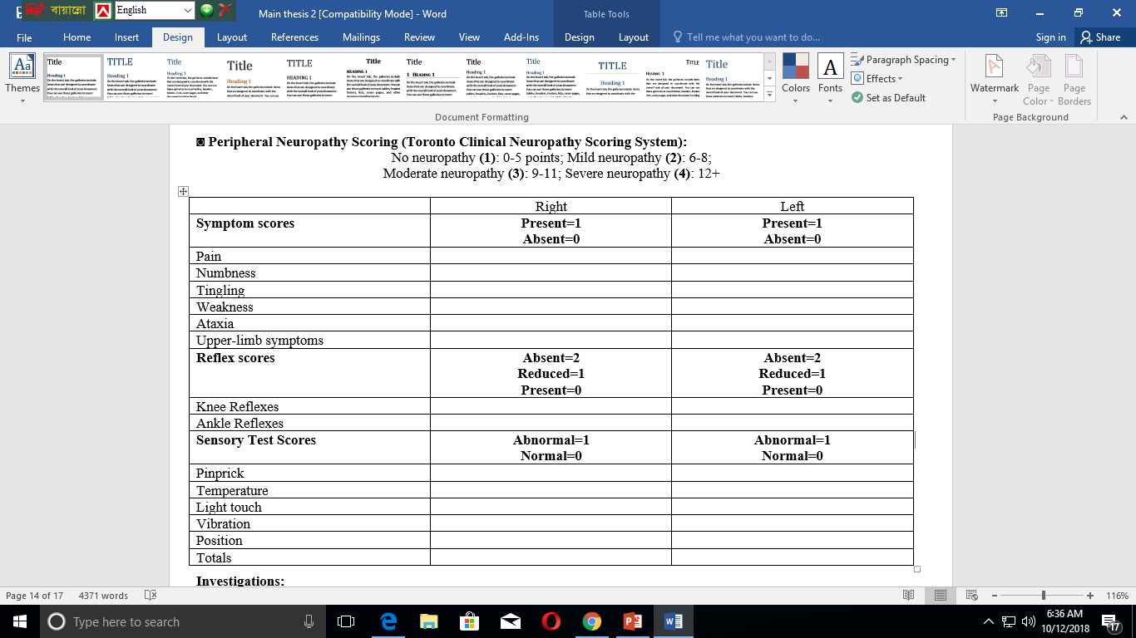
Appendix I

Slide 62
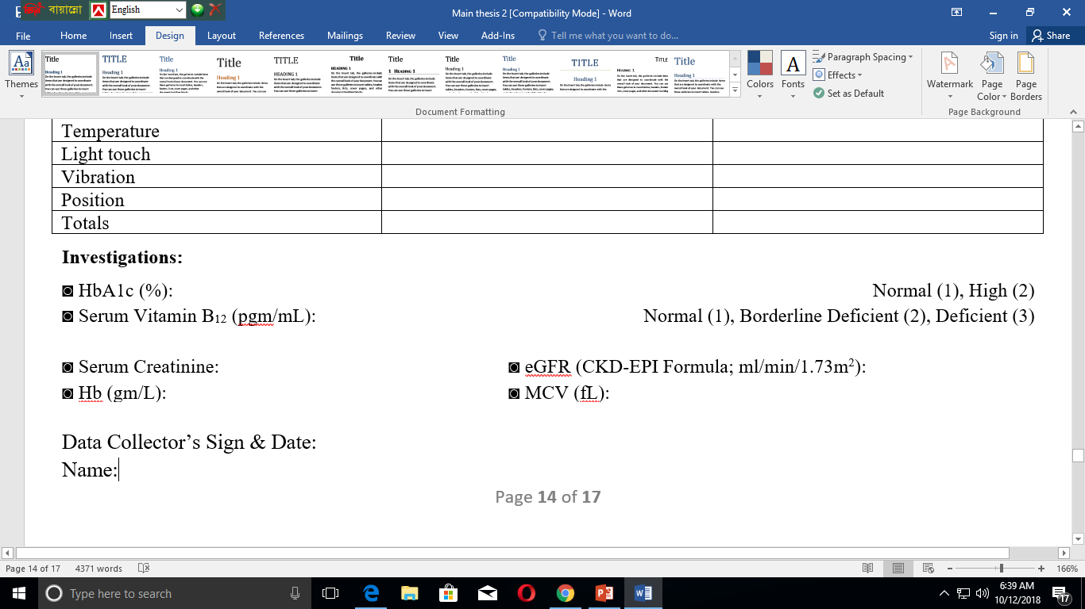
Contd. Appendix I

Slide 63
Appendix-II
Informed Written Consent:
Title of the Study: Vitamin B12 Status in long-term Metformin treated Type 2 Diabetes Mellitus Patients
Investigator’s Name: Dr. Abu Kamran Rahul
Institution: Sylhet M.A.G. Osmani Medical College Hospital, Sylhet.
Do you know the type, purpose and procedure of this study? Yes / No.
Are you sure that you will not face any physical, psychological and social risk for this study? Yes / No.
Are you sure this study will not cause any physical or psychological harm? Yes / No.
Do you have freedom to refuse, participate or withdraw? Yes / No.
Do you loss any fundamental human rights due to participation in this study? Yes / No.
Do you feel that the confidentiality of your information will be maintained? Yes / No.
Do you know that you will get no remuneration or travel expenses due to participation in this study? Yes / No.

Slide 64
Consent form (English)
Getting full information about the purpose, procedure and utility of this study, I give consent to participate in this study. I have not been influenced by anybody or groups or my fundamental human rights have not been violated due to participation in this study.
I am assured that confidentiality of all gathered information will be maintained and will be used for only study purpose and my personal information will not be disclosed to others.
My participation in this study is entirely voluntary. My decision whether or not participate will not prejudice my medical care. I have right to withdraw my consent and discontinue participation at any time without prejudice to me or affect on my medical care.
I will not get any renumeration due to participation in this study.
I am willingly giving signature to this consent form.
Signature of the participant

Slide 65
সম্মতি পত্র
এই গবেষণা কর্মের উদ্দেশ্য, পদ্ধতি ও উপযোগিতা সম্পর্কে পূর্ণ ধারণা পাইয়া এবং নীতিগত বৈশিষ্ট্য সমূহের প্রতি আমার সম্মতি প্রকাশ করিতেছি। গবেষণা কর্মে অংশগ্রহণের জন্য আমি কোন ব্যাক্তি বা গোষ্ঠীর দ্বারা প্রভাভিত হই নাই অথবা আমার মৌলিক মানবাধিকার ক্ষুণ্ণ হয় নাই। আমি নিশ্চিত হইয়াছি যে, এই গবেষণা থেকে সংগৃহীত তথ্যাবলি সম্পূর্ণ গোপন রাখা হইবে। এই তথ্যাবলি কেবলমাত্র গবেষণার কাজেই ব্যাবহার করা হুইবে। আমার ব্যাক্তিগত তথ্যাদি গবেষণাকারী ছাড়া অন্য কাঁরও নিকট প্রকাশ করা হইবেনা।
এই গবেষণায় আমার অংশগ্রহণ সম্পূর্ণ আমার ইচ্ছাধীন। আমি ইচ্ছা করিলে গবেষণায় অংশগ্রহণ নাও করিতে পারি, তাহাতে আমার চিকিৎসার তারতম্য হইবেনা। যে কোন মুহূর্তে আমি আমার সম্মতি প্রত্যাহার করিবার অধিকার রাখি। আমার এই প্রত্যাহার আমার চিকিৎসার উপর কোনরূপ প্রভাব ফেলিবেনা। অতএব, যথাযথ পর্যালোচনা সাপেক্ষে আমি স্বপ্রণোদিত হইয়া এই সম্মতিপত্রে স্বাক্ষর করিতেছি।
অংশগ্রহণকারীর স্বাক্ষর / বাম বৃদ্ধাঙ্গুলির ছাপ
সাক্ষীর স্বাক্ষর / বাম বৃদ্ধাঙ্গুলির ছাপ গবেষকের স্বাক্ষর ও তারিখ

Slide 66
Thank You

